Slide 1
Capstone Project- Sales Analysis
"Revolutionizing Data-Driven Decision Making at Northwind Traders"

Slide 2
Objective:
The primary goal of this Power BI project is to design an insightful and user-friendly dashboard for Northwind Traders. By consolidating and visualizing key performance metrics, the report aims to empower stakeholders with valuable insights into customer behavior, sales patterns, inventory trends, and employee performance. The ultimate impact is to enable Northwind Traders to make informed, data-driven decisions and maintain a competitive edge in the wholesale market landscape.

Slide 3
Dataset Description:
The dataset used for this project is the Northwind database, containing comprehensive sales data for Northwind Traders. The dataset includes tables such as Customers, Employees, Orders, Order Details, Products, Suppliers, Shippers, and Categories, each providing crucial information about different aspects of the company's operations.

Slide 4
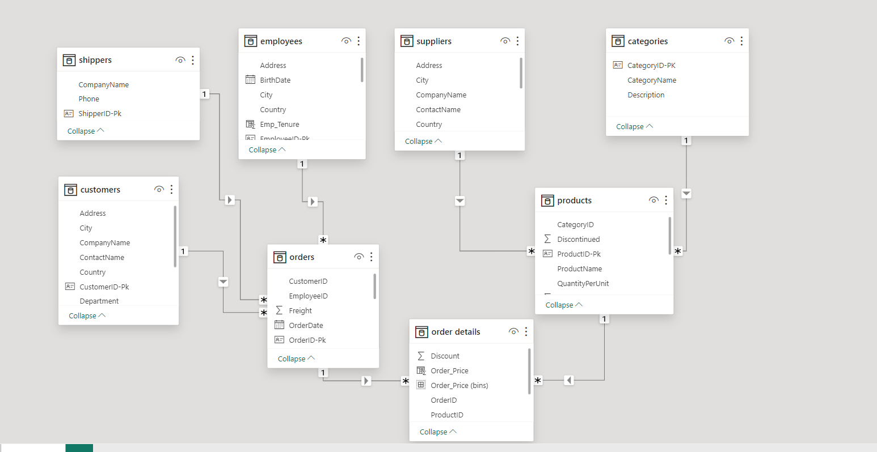
ER Diagram:

Slide 5
Power bi Visuals

Slide 6
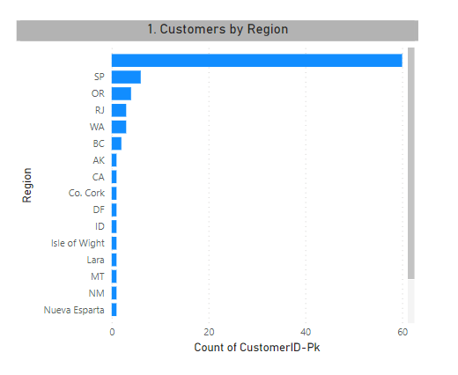
How does customer distribution vary across different regions or customer segments? Can we visualize it on a map or bar chart
Customer distribution by regions, visually representing the concentration of customers in each area. Identifying regions with the highest and lowest customer engagement.

Slide 7
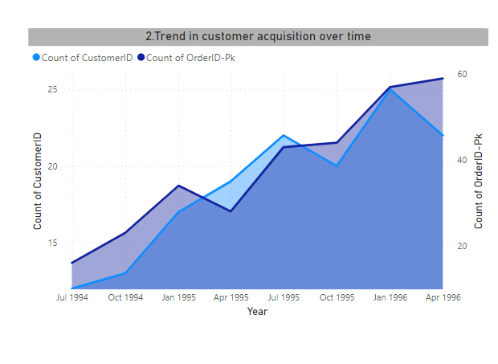
What is the trend in customer acquisition over time? Can we create a line chart or area chart to display it?
From the Graph we can see that there is increase in orders of customers over time.

Slide 8
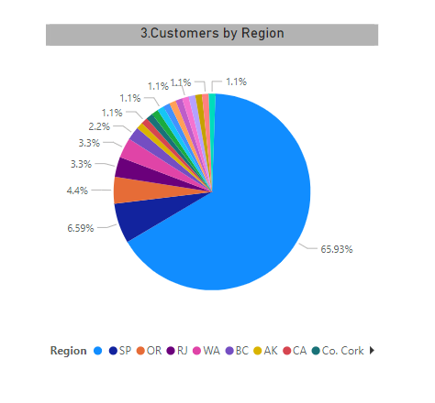
Can we visualize the distribution of customer demographics using histograms or pie charts?
Identifying which regions have the highest percentage of customers. This can help in focusing marketing efforts or tailoring products to the needs of the dominant regions.

Slide 9
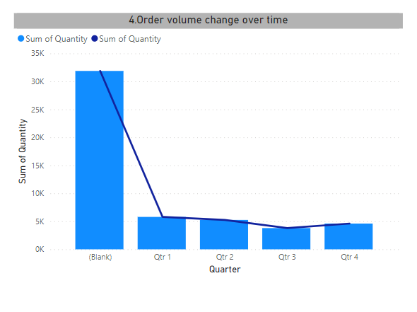
How does order volume change over time? Can we create a time series chart to visualize it
Specific points in time exhibit exceptionally high or low order volumes.
The time series chart reveals a increasing/decreasing trend in order volume over the observed time period.

Slide 10
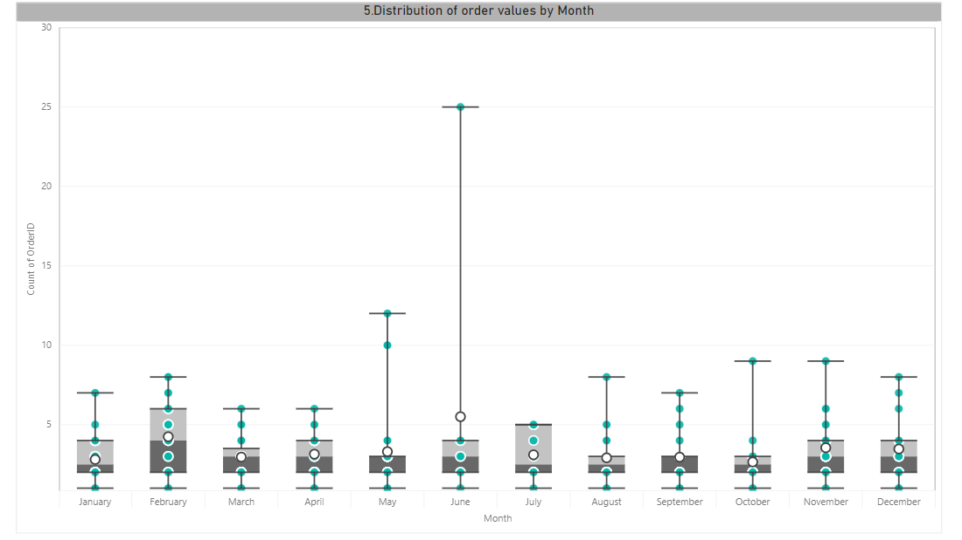
What is the distribution of order values? Can we create a histogram or box plot to display it?
Based on the box plot analysis of order values, it appears that the majority of orders fall within a certain range, as indicated by the length of the box.
The median is positioned in the box, suggesting that the central tendency of the data is higher/lower.

Slide 11
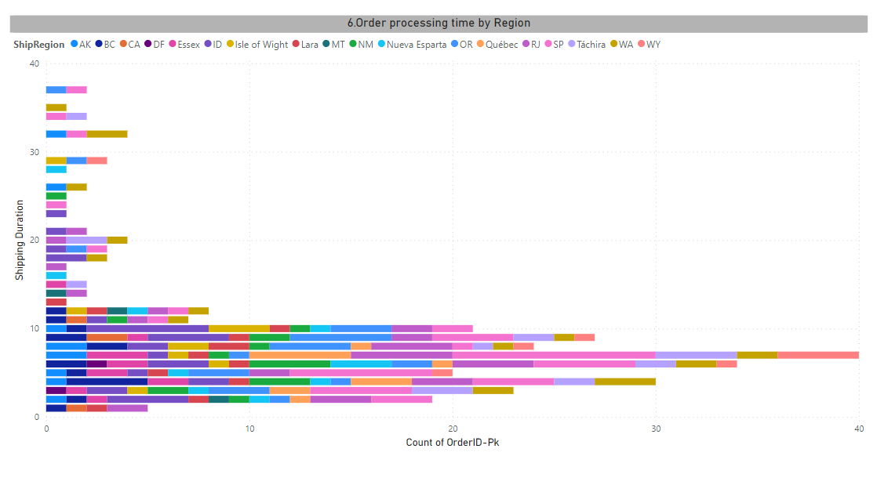
Can we visualize the average order processing time or shipping duration using a bar chart?
By Including number of orders measure with shipping duration dimension in Barchart we can point the specific duration at which the maximum number of orders were delivered.

Slide 12
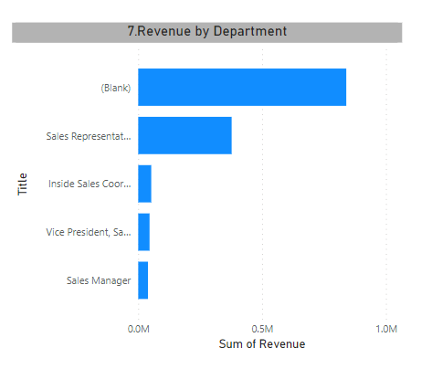
How does employee productivity vary across different departments or job roles? Can we create a stacked bar chart or grouped column chart to visualize it?
Analyzing to acknowledge and reward high-performing departments or roles. Recognizing achievements can boost morale and motivation.

Slide 13
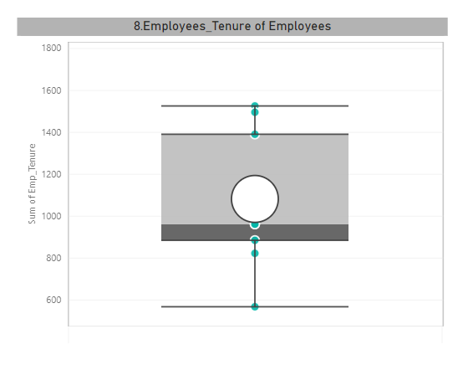
What is the distribution of employee tenure? Can we create a histogram or box plot to display it?
Employee tenure is a crucial metric in understanding the stability and longevity of the workforce within an organization

Slide 14
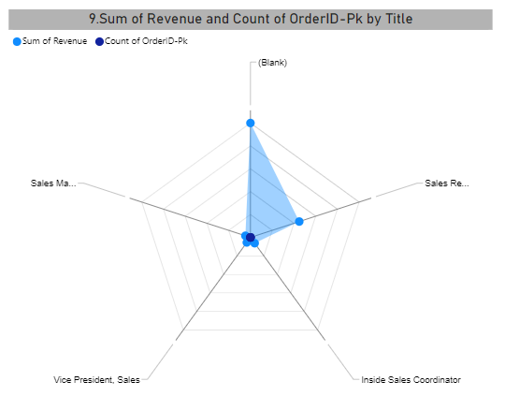
Can we visualize employee performance ratings or KPIs using a radar chart or bullet graph?
The distance from the center to each point on the chart represents the performance score for a specific KPI. A larger area enclosed by the shape indicates better overall performance

Slide 15
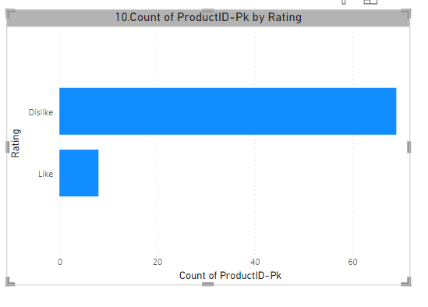
What is the distribution of product ratings or reviews? Can we create a histogram or stacked bar chart to visualize it?
We can Analyse how Customers preceive a product across different rating categories

Slide 16
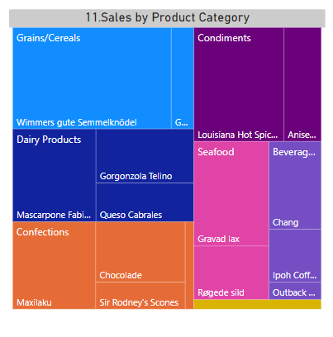
How does the sales volume vary across different product categories? Can we create a bar chart or tree map to display it?
Analyzing the spread of sales across different categories. A diverse product portfolio with balanced sales across various categories may indicate a healthy and resilient business.

Slide 17
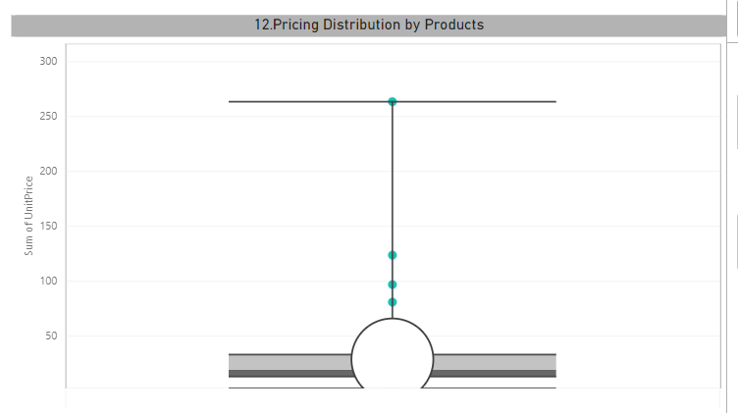
Can we visualize the pricing distribution of products using a box plot or violin plot?
Visualizing the pricing distribution of products using a box plot is an effective way to understand the central tendency, spread, and potential outliers in the data

Slide 18
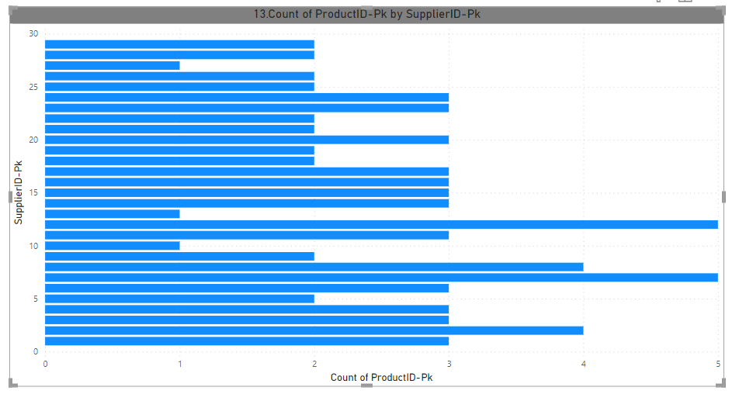
What is the distribution of supplier ratings or performance metrics? Can we create a bar chart or radar chart to visualize it?
We can analyse the count of Products distributed by each supplier.

Slide 19
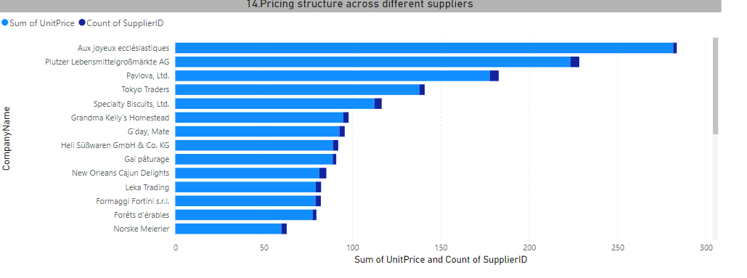
How does the cost or pricing structure vary across different suppliers? Can we create a box plot or stacked bar chart to display it?
Identify and acknowledge the variations in pricing or costs among different suppliers
We can determine which suppliers are cost leaders and which are laggards.

Slide 20
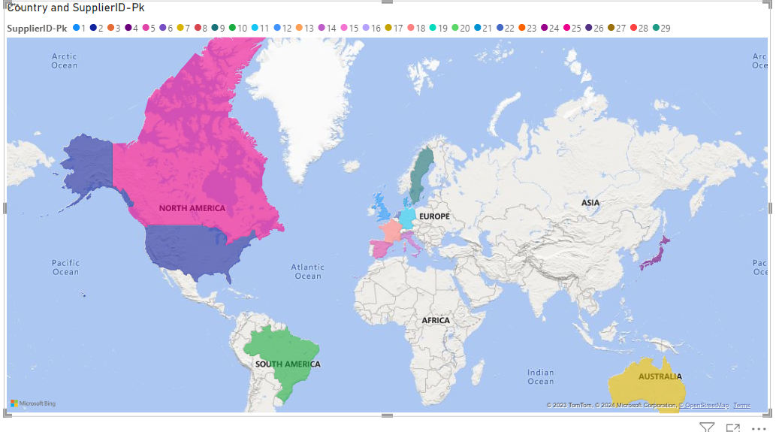
Can we visualize the geographical distribution of suppliers using a map or bubble chart?
We can Identify regions or countries with a high concentration of suppliers.

Slide 21
EDA Analysis

Slide 22
What are the key factors influencing customer retention or loyalty based on the dataset?
We can measure the loyalty of Customers by Observing Maximum Number of Orders.
Most Of the Orders done from Sava-a-lot Markets and Ernst Handel.

Slide 23
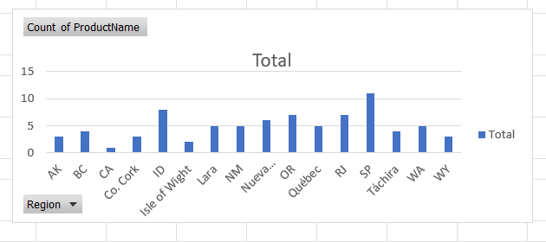
How do customer preferences vary based on their location or demographics? Can we explore this through interactive visualizations?
Through the Analyses we can conclude the customer Preferences region wise Product and categories.

Slide 24
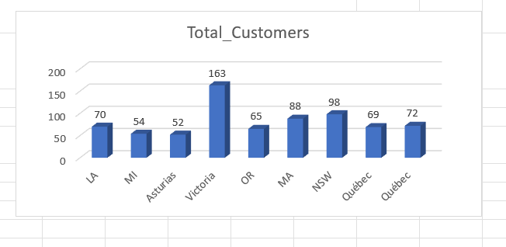
Are there any interesting patterns or clusters in customer behavior that can be visualized to identify potential market segments
We can analyze the customer behaviour through potential markets i.e,suppliers.

Slide 25
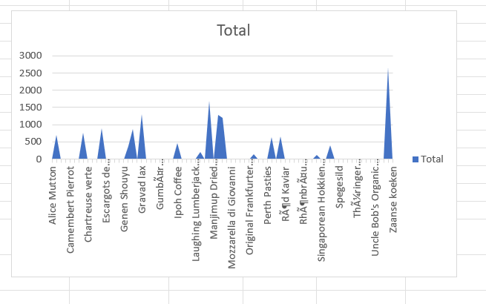
Are there any specific product categories or SKUs that contribute significantly to order revenue? Can we identify them through visualizations
We can conclude which Product name has highest revenue.
In which category product is giving max and min Revenue
In which category we are having maximum revenue
In which category we can enhance or exchange the product quality.
We can also conclude which product is having better revenue as compare to other products of same Category.

Slide 26
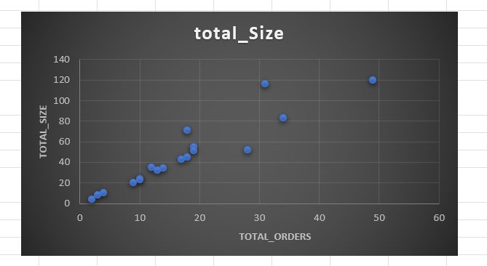
Are there any correlations between order size and customer demographics or product categories? Can we explore this visually using scatter plots or heatmaps
The Graph represents the correlation between Customer Region and Product categories i.e,size and total Orders.

Slide 27
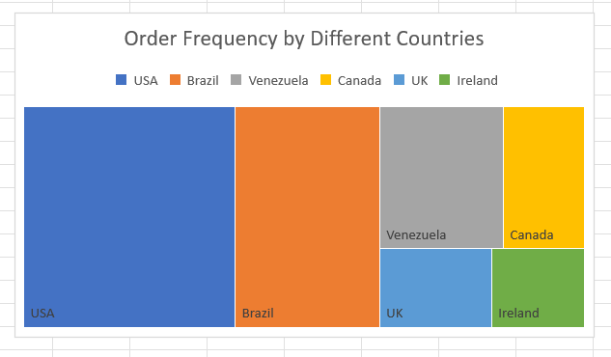
How does order frequency vary across different customer segments? Can we visualize this using bar charts or treemaps
We can observe the pattern of number of orders across different countries.
We get to know which country is having highest and lowest number of orders.

Slide 28
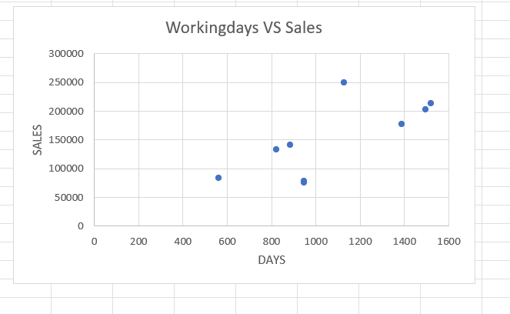
Are there any correlations between employee satisfaction levels and key performance indicators? Can we explore this visually through scatter plots or line charts
The Graph shows the correlation between Employee working days and Sales of Employees.

Slide 29
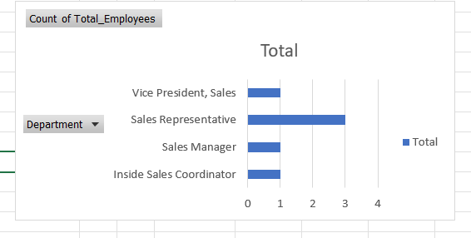
How does employee turnover vary across different departments or job roles? Can we visualize this using bar charts or heatmaps
We can Analyze the Employee details regarding each department year wise.

Slide 30
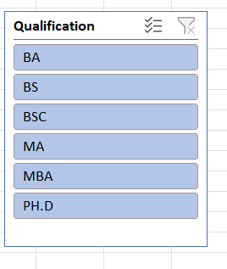
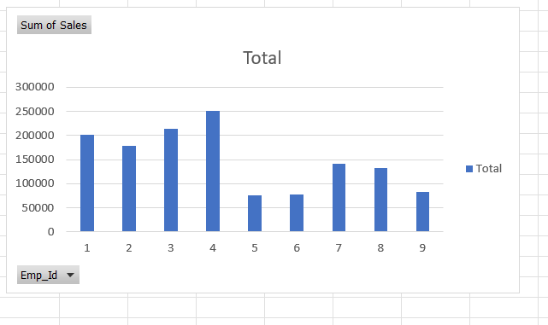
Can we identify any patterns or clusters in employee skill sets or qualifications through visualizations? How can this information be used for talent management
Graph Shows the total Sales of each employee regarding the Qualification.

Slide 31
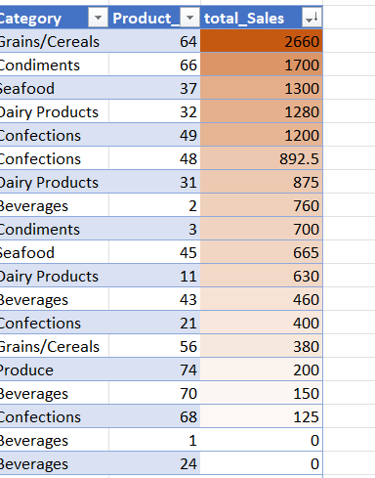
Are there any correlations between product attributes (e.g., size, color, features) and sales performance? Can we explore this visually using scatter plots or heatmaps
We can see the correlation of product category and sales and in Grains category we are having more number of Sales.

Slide 32
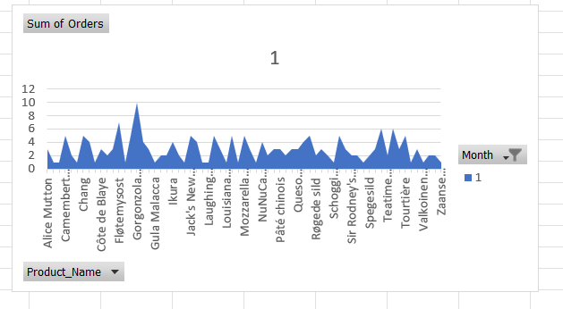
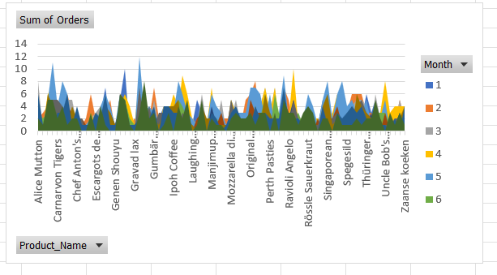
How does product demand fluctuate over different seasons or months? Can we visualize this through line charts or area charts
By taking monthly product sales we can analyse which product is in more demand and in which season.

Slide 33
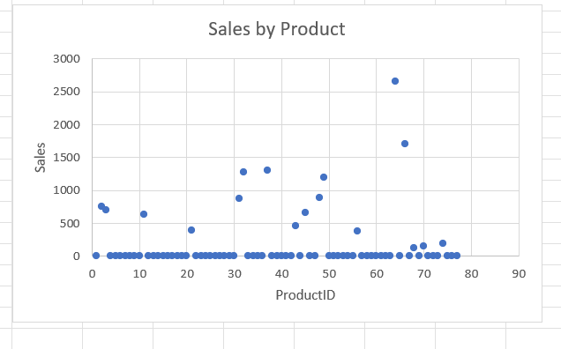
Can we identify any outliers or anomalies in product performance or sales using visualizations? How can this information be used for product optimization
Product Id with 64 is an outlier with having highest sales 2660

Slide 34
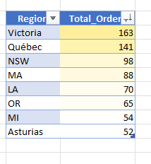
Are there any correlations between supplier attributes (e.g., location, size, industry) and performance metrics (e.g., on-time delivery, product quality)? Can we explore this visually through scatter plots or heatmaps
Analysing total Orders with respect to Region we can get to know correlation between them and the Region Victoria is having more number of Orders.

Slide 35
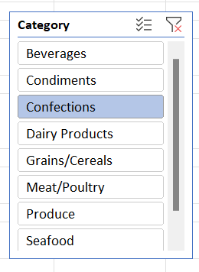
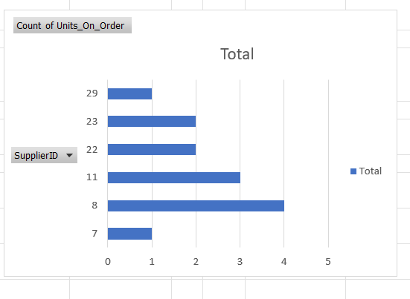
How does supplier performance vary across different product categories or departments? Can we visualize this using stacked bar charts
Analysing total sales with respect to product Categories along with its supplier details will help us in identifying performance of supplier.

Slide 36
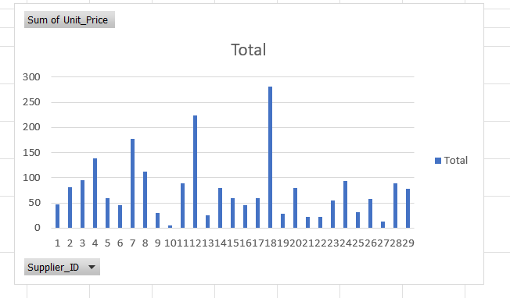
Can we identify any trends or patterns in supplier costs or pricing structures through visualizations? How can this information be used for procurement optimization
We can see the different trends occurred in the pricing Structure of Suppliers.
Analysing these helps in order to obtain increase in order value which is used for procurement optimization.

Slide 37
Thankyou

